Slide 1

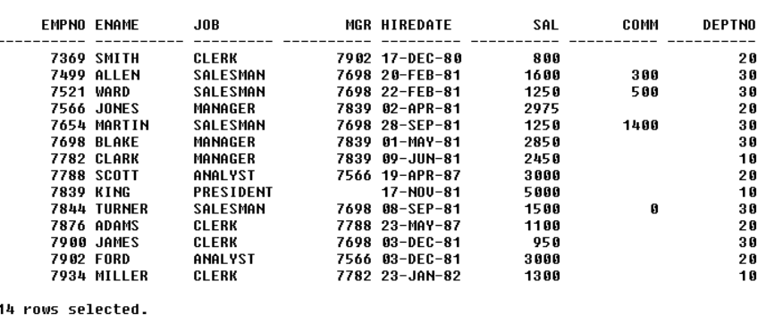
EMPLOYEE TABLE
INPUT:
OUT PUT:

Slide 2
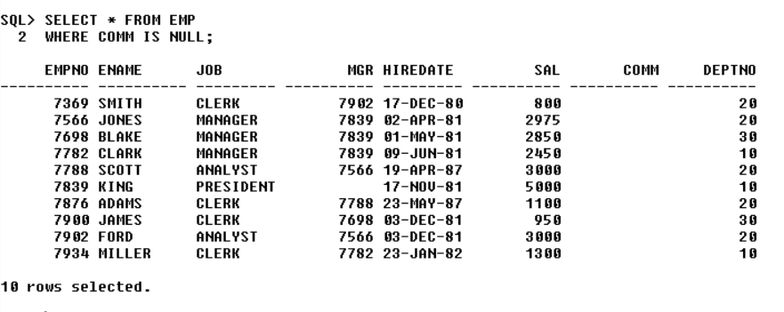
QUERY :
1.LIST ALL THE EMPLOYEES WHOSE COMMISSION IS NULL
OUT PUT:

Slide 3
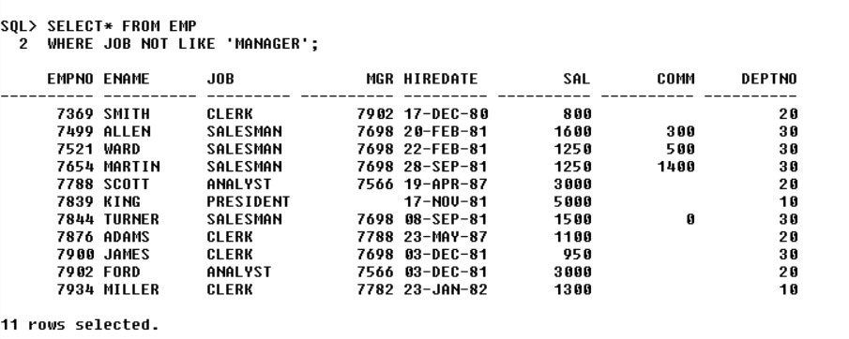
QUERY :
2.LIST ALL THE EMPLOYEES WHO DON’T HAVE A REPORTING MANAGER
OUT PUT:

Slide 4
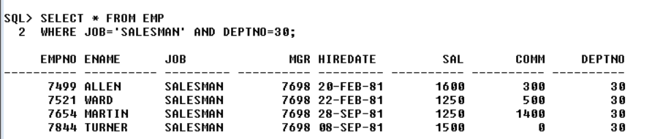
QUERY:
3.LIST ALL THE SALESMEN IN DEPT30
OUT PUT:

Slide 5
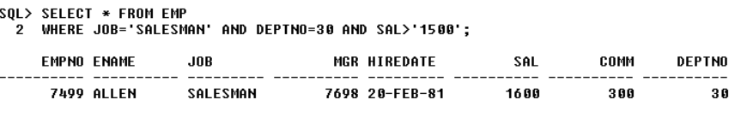
QUERY :
4.LIST ALL THE SALESMAN IN DEPT NUMBER 30 AND HAVING SALARY GREATER THAN 1500
OUT PUT:

Slide 6
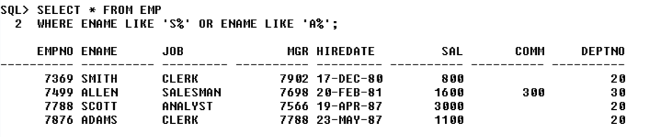
QUERY :
5.LIST ALL THE EMPLOYEES WHOSE NAME STARTS WITH ‘S’ OR ‘A’
OUT PUT:

Slide 7
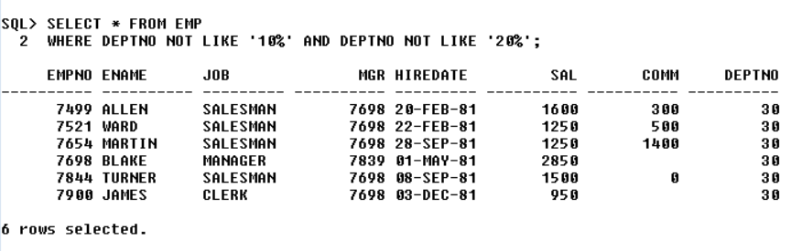
QUERY:
6.LIST ALL THE EMPLOYEES EXCEPT THOSE WHO ARE WORKING IN DEPT 10 & 20.
OUT PUT:

Slide 8
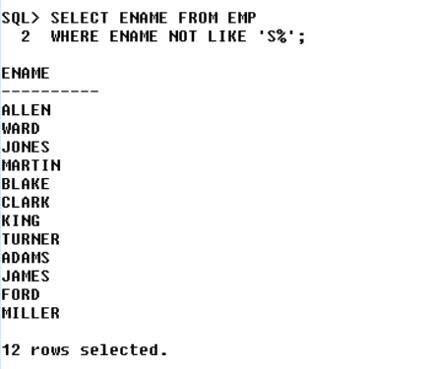
QUERY:
7.LIST THE EMPLOYEES WHOSE NAME DOES NOT START WITH ‘S’
OUT PUT:

Slide 9
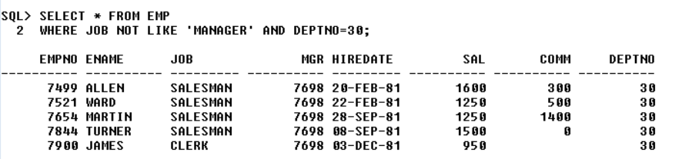
QUERY :
8.LIST ALL THE EMPLOYEES WHO ARE HAVING REPORTING MANAGERS IN DEPT 10.
OUT PUT

Slide 10
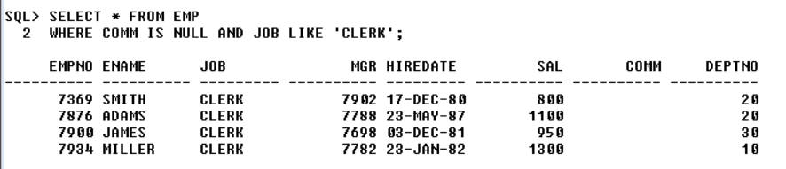
QUERY:
9.LIST ALL THE EMPLOYEES WHOSE COMMISSION IS NULL AND WORKING AS CLERK.
OUT PUT:

Slide 11
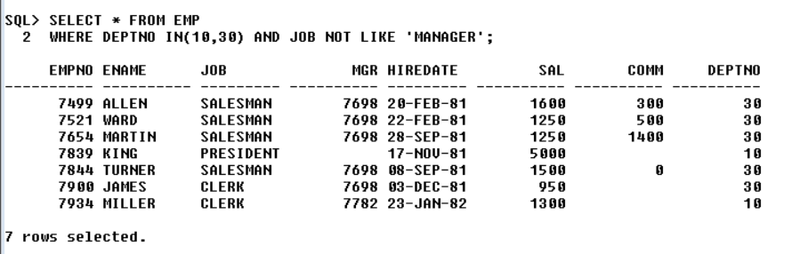
QUERY :
10.LIST ALL THE EMPLOYEES WHO DON’T HAVE A REPORTING MANAGER IN DEPTNO 10 OR 30.
OUT PUT:

Slide 12
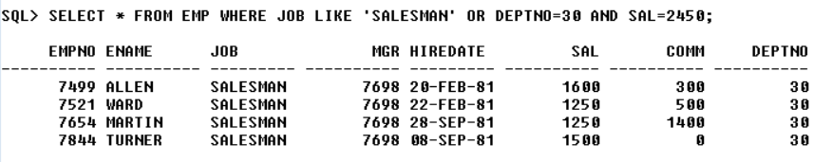
QUERY :
11.LIST ALL THE SALESMAN IN DEPT NO 30 WITH SAL MORE THAN 2450.
OUT PUT:

Slide 13
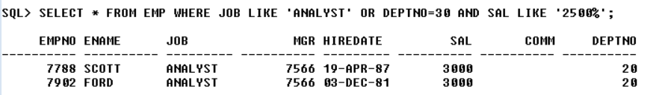
QUERY :
12.LIST ALL THE ANALYST IN DEPTNO 20 AND HAVING SALARY GREATER THAN 2500.
OUT PUT:

Slide 14
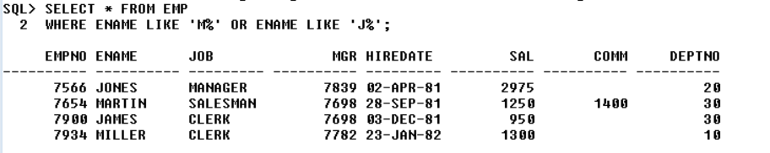
QUERY:
13.LIST ALL THE EMPLOYEES WHOSE NAME STARTS WITH ‘M’ OR ‘J’
OUT PUT:

Slide 15
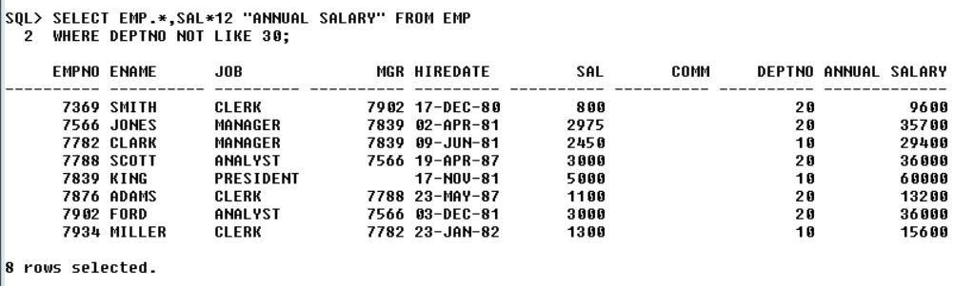
QUERY:
14.LIST ALL THE EMPLOYEES WITH ANNUAL SALARY EXCEPT THOSE WHO ARE WORKING IN DEPT 30.
OUT PUT:

Slide 16
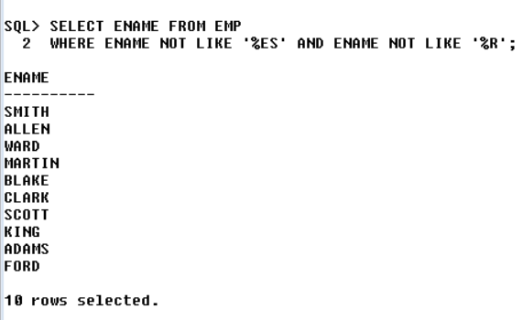
QUERY :
15.LIST THE EMPLOYEES WHOSE NAME DOES NOT END WITH ‘ES’ OR ‘J’.
OUT PUT:

Slide 17
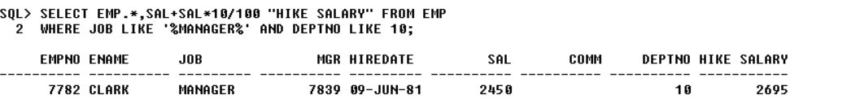
QUERY:
16.LIST ALL THE EMPLOYEES WHO ARE HAVING REPORTING MANAGERS IN DEPTNO 10 ALONG WITH 10% HIKE IN SALARY.
OUT PUT:

Slide 18
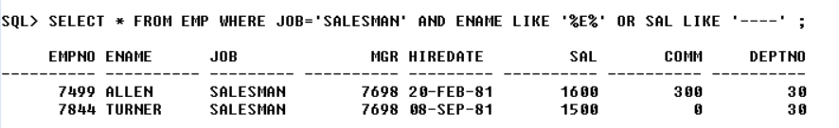
QUERY :
17.DISPLAY ALL THE EMPLOYEE WHO ARE SALESMANS HAVING ‘E, AS THE LAST BUT ONE CHARACTER IN ENAME BUT SALARY HAVING EXACTLY 4 CHARACTER.
OUT PUT:

Slide 19
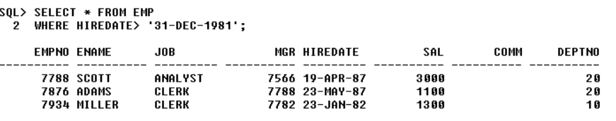
QUERY :
18.DISPLAY ALL THE EMPLOYEE WHO ARE JOINED AFTER YEAR 1981.
OUT PUT:

Slide 20
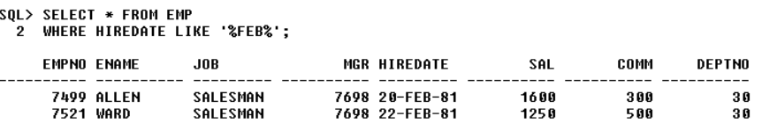
QUERY :
19.DISPLAY ALL THE EMPLOYEE WHO ARE JOINED IN FEB.
OUT PUT:

Slide 21
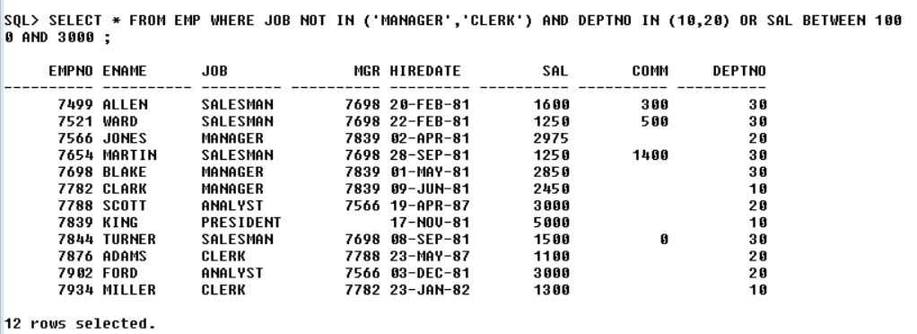
QUERY :
20.LIST THE EMPLOYEES WHO ARE NOT WORKING AS MANAGERS AND CLERKS IN DEPT NO 10 AND 20 WITH A SALARAY IN THE RANGE OF 1000 TO 3000.
OUT PUT:

